Slide 1
Ship
- dimX : int
- dimY : int
- location : ShipPoint[]
- shipStatus : Boolean
- shipName : String
- hitCapacity : int
- currentHitCount: int
- …
+ setDimX(x : int) : void
+ setDimY(y : int) : void
+ getDimX() : int
+ getDimY() : int
+ setLocation(points : ShipPoint[]) : void
+ getLocation() : ShipPoint[]
+ getStatus() : Boolean
+ setHitCapacity () : void
+ getCurrentHitCount() : int
+ getPrcntDmge() : double
+ toString() : void
+ …
Fleet
- ships : Ship[]
- shipNames : String[]
- shipDimens: int[]
- fleetStatus: Boolean
- …
+ checkStatus() : Boolean
+ updateStatus() : void
+ getShip(index: int) : Ship
+ …
StrategyBoard
- board : int[][]
- battleFleet : Fleet
- …
+ initBoard() : void
+ createFleet() : void
+ getFleet() : Fleet
+ withinGrid( x: int, y: int) : Boolean
+ spotTaken( x: int, y: int) : Boolean
+ checkFleetPositionValidity() : Boolean
+ …
ShipPoint
+ x : int
+ y : int
+ hitStatus : Boolean
+ Point() : void
+ Point(x: int, y: int) : void

Slide 2
GameController
- user : UserPlayer
- aiOpp : AIOpponent
- humOpp : humOpponent
- winner : String
- gameOver : Boolean
+ startGame() : void
+ switchTurn() : void
+ getWinner() : String
+ rematch() : Boolean
+ …

Slide 3
UserPlayer
- stratBoard : StrategyBoard
- username : String
- score : int
- hits : int
- misses : int
+ initBoards() : void
+ turn() : void
+ getScore() : int
+ getHits() : int
+ getMisses() : int
+ updateScore(points : int) : void
+ …
AIOpponent
- stratBoard : StrategyBoard
- hits : int
- misses : int
+ initBoards() : void
+ turn() : void
+ …
humanOpponent
- stratBoard : StrategyBoard
- username : String
- score : int
- hits : int
- misses : int
+ initBoards() : void
+ turn() : void
+ getScore() : int
+ getHits() : int
+ getMisses() : int
+ updateScore(points : int) : void
+ …

Slide 4
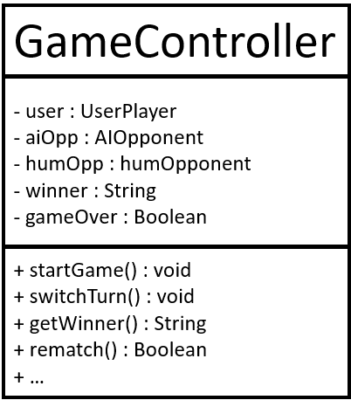
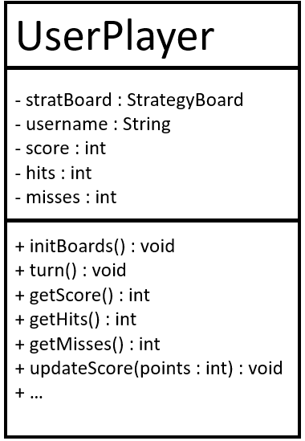
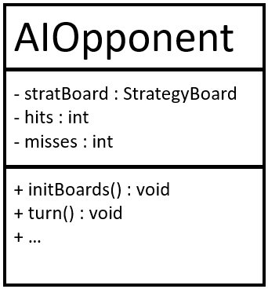
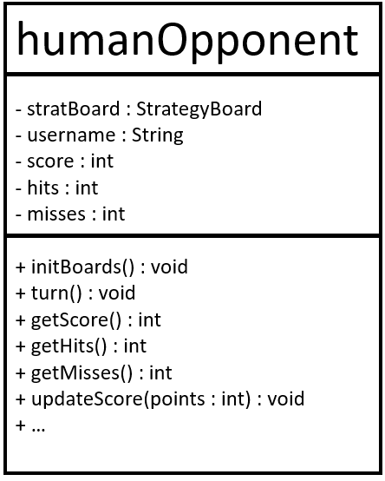
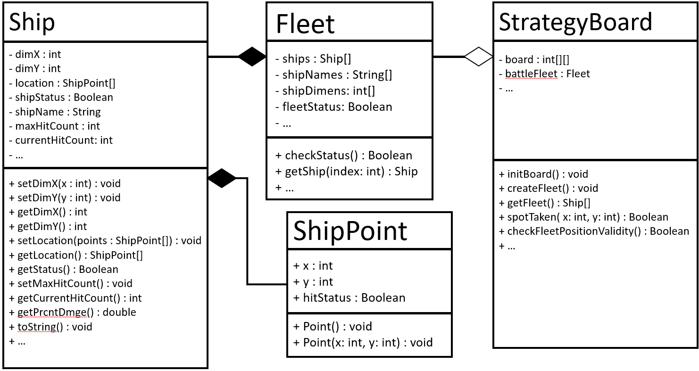

Slide 5
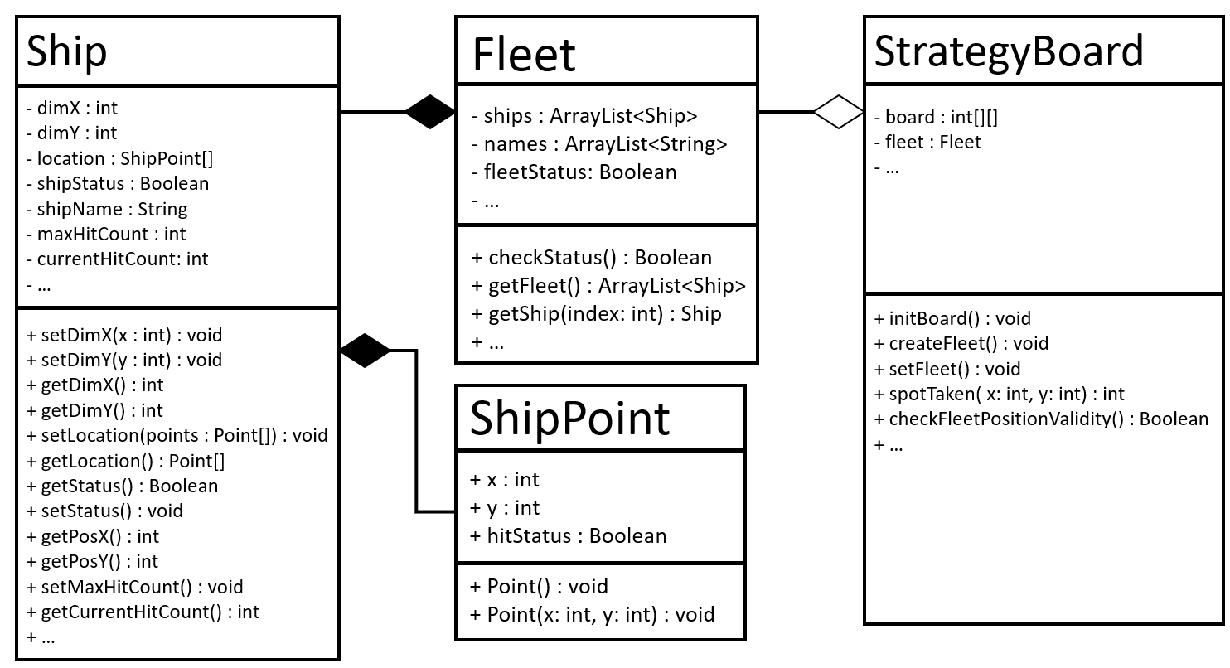
AttackBoard
- board : int[][]
- fleet : Fleet
- …
+ initBoard() : void
+ createFleet() : void
+ setFleet() : void
+ spotTaken( x: int, y: int) : int
+ checkFleetPositionValidity() : Boolean
+ …

Slide 6
Java Class: Ship
Instance Variables:
dimX (int) – width of ship
dimY (int) – length of ship
location (ShipPoint[]) – the coordinates taken by the ship on the board
shipStatus (Boolean) – status of ship (active = true/1, sunk = false/0).
shipName (String) – ship’s name (e.g. “Aircraft Carrier”, “Cruiser”, “Destroyer”, “Submarine”, “Corvette”, etc.)
hitCapacity (int) – number of attackable points on the ship
currentHitCount (int) – number of points on ship hit by opponent
Example: Ship B1 after being created
dimX = 4 (4 units wide)
dimY = 2 (2 units long)
location = Point[dimX*dimY] (points not set yet)
shipStatus = true (ship is active, not sunk)
shipName = “Aircraft Carrier”
maxHitCount = 8 (# of attackable points on ship)
currentHitCount = 0 (no points hit yet)
x
4
y
2
B1
Aircraft Carrier

Slide 7
Java Class: Ship
Class Methods:
setDimX(x : int) – sets ship’s width
setDimY(y : int) – sets ship’s length
getDimX() – returns ship’s width
getDimY() – returns ship’s length
setLocation(points : ShipPoint[]) – sets location of the Ship object on the board
getLocation() – returns array of ShipPoint objects
getStatus() – returns true is ship is active, false if ship is sunk.
setHitCapacity() – sets amount of damage required for the ship to sink (in # of attackable points on the ship)
getCurrentHitCount() – returns ship’s current damage (in # of points on the ship that are attacked) in int data type.
getPrcntDmge(ship: Ship) – takes a Ship object and returns the percent damage it’s taken (in double data type).

Slide 8
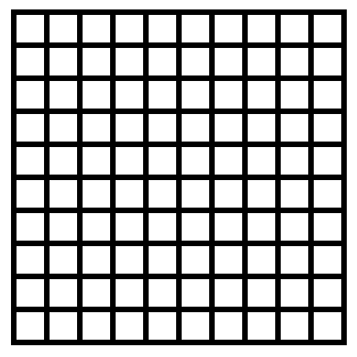
Strategy Board (initialization of P1’s board):
0
0
0
0
0
0
0
0
0
0
0 = No ships are placed
0
0
0
0
0
0
0
0
0
0
0
0
0
0
0
0
0
0
0
0
0
0
0
0
0
0
0
0
0
0
0
0
0
0
0
0
0
0
0
0
0
0
0
0
0
0
0
0
0
0
0
0
0
0
0
0
0
0
0
0
0
0
0
0
0
0
0
0
0
0
0
0
0
0
0
0
0
0
0
0
0
0
0
0
0
0
0
0
0
0

Slide 9
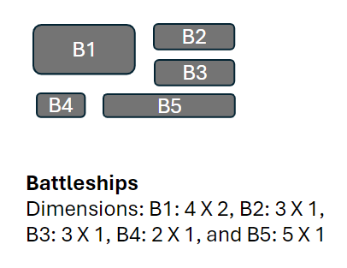
Strategy Board (example below of P1’s board after entire fleet is placed):
1
1
1
1
0
0
0
0
0
0
0 = where no ship is placed
1 = where B1 is placed
2 = where B2 is placed
3 = where B3 is placed
4 = where B4 is placed
5 = where B5 is placed
1
1
1
1
0
0
0
0
0
0
0
0
0
0
0
5
5
5
5
5
0
0
0
0
0
0
0
0
0
0
0
0
0
2
2
2
0
0
0
0
0
0
0
0
0
0
0
0
0
0
0
0
0
0
0
0
0
0
0
0
0
3
0
0
0
0
0
0
0
0
0
3
0
0
0
0
0
4
4
0
0
3
0
0
0
0
0
0
0
0
checkFleetPositionValidity() would return true, as all ships are in valid positions (no overlapping or crossing grid boundaries).
Only if checkFleetPositionValidity() is true, can Player 1 continue to the first round of attacks.

Slide 10
Strategy Board (example below of P1’s board after hits have been exchanged):
1
1
1
1
0
0
0
9
0
0
0 = where no ship is placed
1 = where B1 is placed
2 = where B2 is placed
3 = where B3 is placed
4 = where B4 is placed
5 = where B5 is placed
9 = miss (no ship was hit)
“1” appended = where B1 ship is hit
“2” appended = where B2 ship is hit
“3” appended = where B3 ship is hit
“4” appended = where B4 ship is hit
“5” appended = where B5 ship is hit
1
1
1
1
0
0
0
0
0
0
0
0
0
9
0
5
5
5
5
5
0
0
0
0
0
0
0
0
0
0
0
9
0
22
22
2
0
0
9
0
0
0
0
0
0
0
0
0
0
0
9
0
0
0
0
0
0
9
0
0
0
3
0
9
0
0
0
0
0
0
0
3
0
0
0
0
0
4
4
0
0
3
0
0
0
0
0
0
0
0
Player 1’s strategy board is modified (as above) through the rounds. If Player 1 suffers a hit, then an additional integer of the same value (1, 2, 3, 4, or 5) is appended onto the value in the board[][] at that point/coordinate.
If the opponent of Player 1 misses, a integer 9 is stored at that point/coordinate.

Slide 12
x
y

